Slide 1
Lecture #7
SOFT COMPUTING
INT508

Slide 2
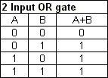
Suppose w1=0.6 and w2=0.8
Threshold =0.1, α=0.5
Learn the NN using Delta learning rule and minimise the error

Slide 3
Round- 1
Case 1: A=x1=0, B=x2=0
So, sum=0*0.6+0*0.8=0
Since 0<1 , predicted output=0
Thus no error because predicted value= Target value
Case-2: A=x1=0, B=x2=1
So, sum=0*0.6+1*0.8=0.8
Since 0.8<1 , predicted output=0
But here target output=1
Find e=T-Y=1-0=1

Slide 4
∆w_{i}= α*e*x_{i}
Here ∆w_{i} = weight change for i^{th} ⁡pattern;
α = the positive and constant learning rate;
x_{i}= the input value from pre-synaptic neuron;
e = (t−yin) the difference between the desired/target output and the actual output ⁡yin
when t ≠ y, then
w(new)=w(old)+Δw

Slide 5
∆w₁= α*e*x₁ = 0.5*1*0=0
∆w₂= α*e*x₂ = 0.5*1*1=0.5
W1(new)=w1+ ∆w₁=0.6+0=0.6
W2(new)=w2+ ∆w₂=0.8+0.5=1.3
Case 3:
A=x1=1, B=x2=0
So, sum=1*0.6+0*1.3=0.6
Since 0.6<1 , predicted output=0
But here target output=1
Find e=T-Y=1-0=1

Slide 6
∆w₁= α*e*x₁ = 0.5*1*1=0.5
∆w₂= α*e*x₂ = 0.5*1*0=0
W1(new)=w1+ ∆w₁=0.6+0.5=1.1
W2(new)=w2+ ∆w₂=1.3+0=1.3
Case 4:
A=x1=1, B=x2=1
So, sum=1*1.1+1*1.3=2.4
Since 2.4>1 , predicted output=1
But here target output=1
Find e=T-Y=1-1=0

Slide 7
Round-2
Case 1:
A=x1=0, B=x2=0
So, sum=0*1.1+0*1.3=0
Since 0<1 , predicted output=0
But here target output=0
Find e=T-Y=0

Slide 8
Case 2:
A=x1=0, B=x2=1
So, sum=0*1.1+1*1.3=1.3
Since 1.3>1 , predicted output=1
But here target output=1
Find e=T-Y=1-1=0

Slide 9
Case 3:
A=x1=1, B=x2=0
So, sum=1*1.1+0*1.3=1.1
Since 1.1>1 , predicted output=1
But here target output=1
Find e=T-Y=1-1=0

Slide 10
Case 4:
A=x1=1, B=x2=1
So, sum=1*1.1+1*1.3=2.4
Since 2.4>1 , predicted output=1
But here target output=1
Find e=T-Y=1-1=0

Slide 11
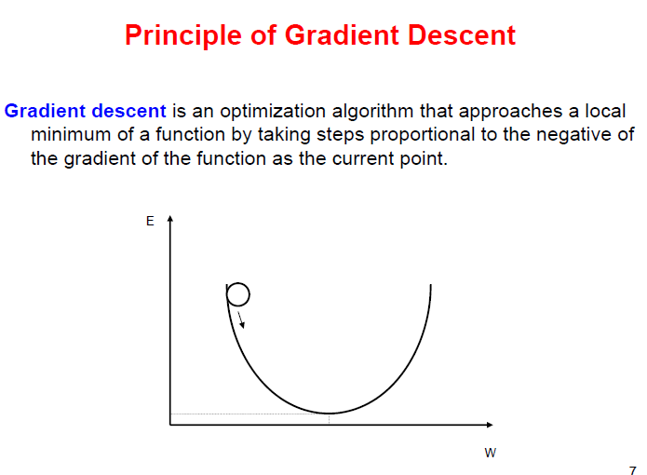

Slide 12
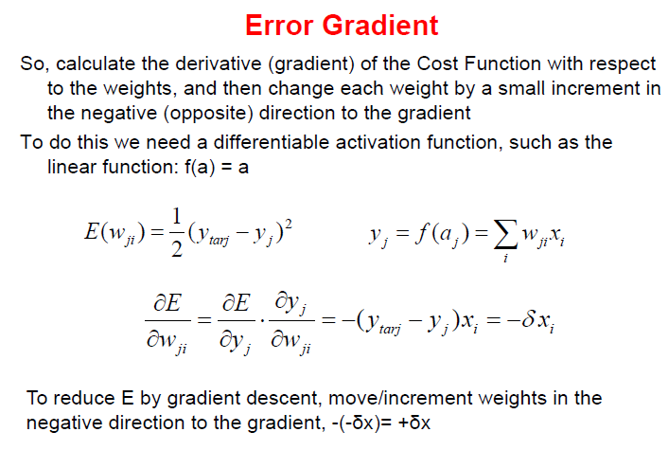


Slide 13
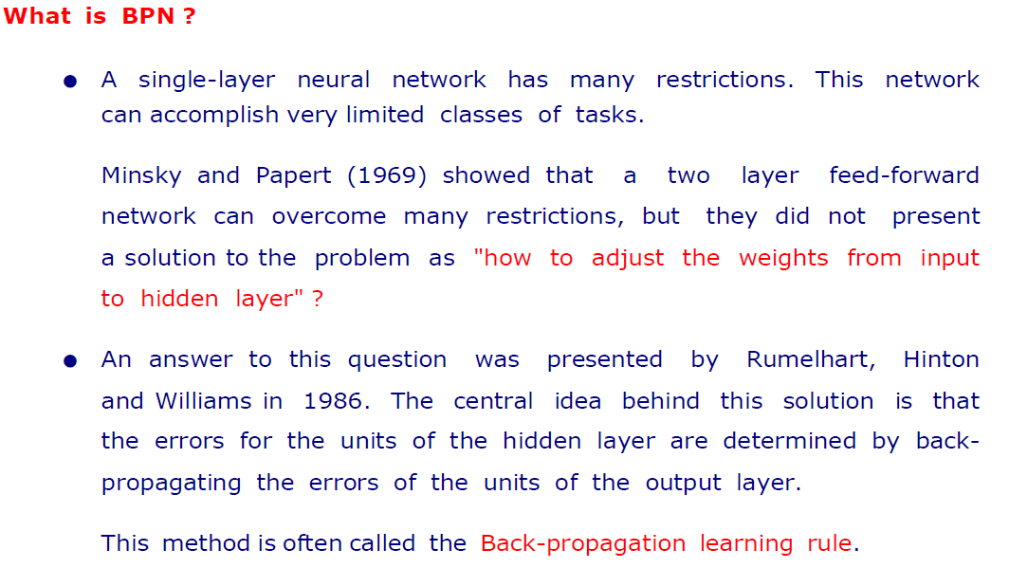
Back propagation neural networks

Slide 14
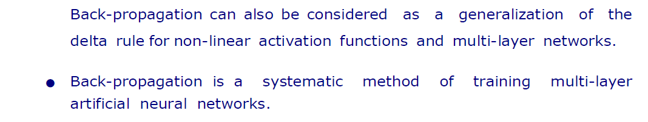
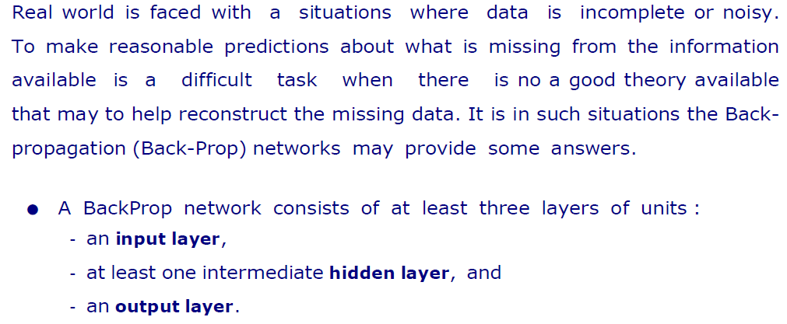
Back propagation neural networks

Slide 15
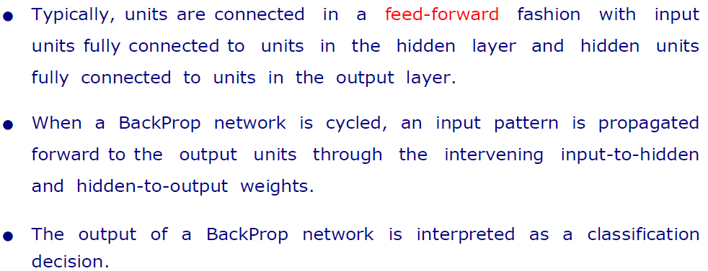
Back propagation neural networks

Slide 16
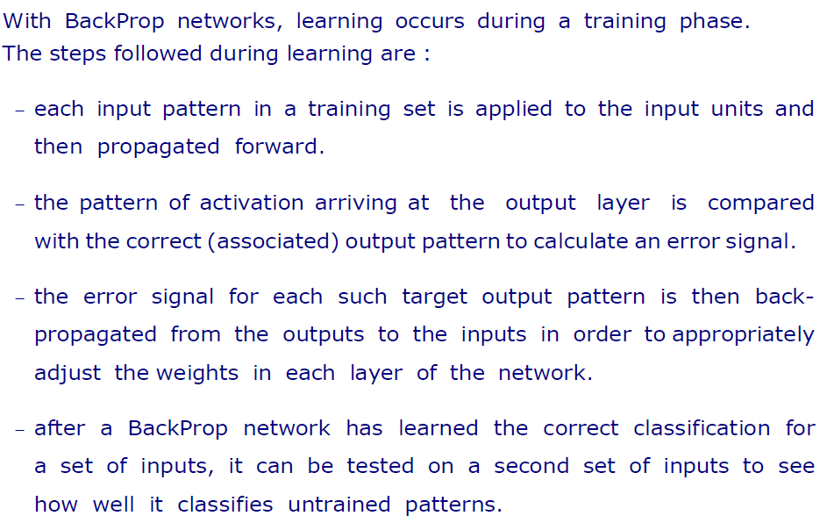
Back propagation neural networks

Slide 17
Back propagation neural networks
Back propagation algorithm calculates the gradient of the error function.
Back propagation can be written as a function of the neural network.
Back propagation algorithms are a set of methods used to efficiently train artificial neural networks following a gradient descent approach which exploits the chain rule.

Slide 18
Back propagation neural networks
The main features of Backpropagation are the iterative, recursive and efficient method through which it calculates the updated weight to improve the network until it is not able to perform the task for which it is being trained.
Derivatives of the activation function to be known at network design time is required to Back propagation.

Slide 19
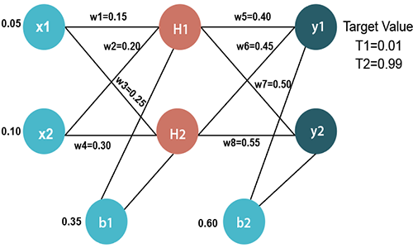
Back propagation neural networks

Slide 20
Back propagation neural networks
Input values
X1=0.05 X2=0.10
Initial weight
W1=0.15 w5=0.40
W2=0.20 w6=0.45
W3=0.25 w7=0.50
W4=0.30 w8=0.55
Bias Values
b1=0.35 b2=0.60
Target Values
T1=0.01 T2=0.99

Slide 21

12/12/14
CSE510, Lovely Professional University, Phagwara

